Slide 1


Slide 2
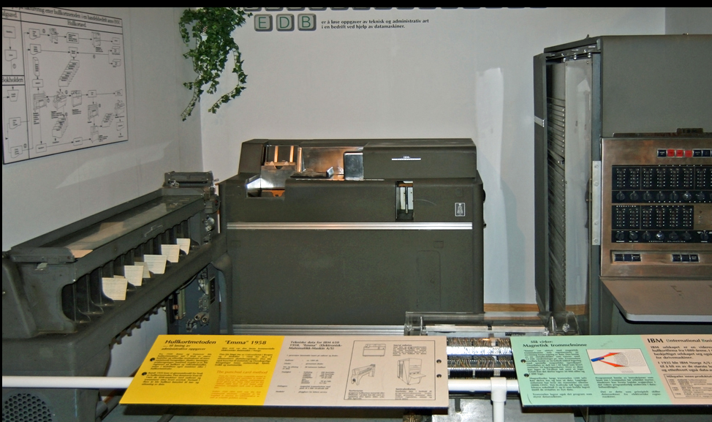
Online Dating Fun Fact
Online dating seems like a relatively new fad that only emerged in the last 20-30 years.
Online dating started in a class project just like this at Stanford University in 1959.
Happy Families Planning Services
What if you had to code on this? >>

Slide 3
Conception and Motivation
Our group decided there were several stereotypes surrounding dating apps that we wanted to tackle.
They only focus in on the superficial
Focus on picture
Just for hook-ups
You have no idea who the other user is on the other end of that server.
Catfish
Authentic self
Online dating sites only focus in on the superficial.
Proposed Concept:
Create an app that focuses on the dater’s interests and highlights other attributes not associated with physical appearance.
Once the dater(1) selects a dater(2) based on these things; dater(2) gets to view the same information about dater(1) and decides whether to accept the match.
Once they both accept, then they get to view all the usual dating information.
Who is the other user? Are they who they say they are?
Proposed Concept:
Create an app that provides a thorough authentication process using information input by the user.
User cannot pass ‘GO’ if they do not check all the authentication boxes.
Blue Ocean: Slide 2

Slide 4
Our Process
Research how other people have done similar projects.
Let’s be real! We all did it!
Choose API’s.
Build project around these API’s to render the following:
Functionality
Accessibility
Dynamic Coding
Code match logic to choose compatibility based on specific parameters:
Individual interests
Creativity
Location
Regret picking such a beastly project:
Pull ourselves up by our bootstraps (get it?)
Understand what ideas we had to implement in our time frame.
Submit Final Project
Meets Acceptance Criteria
Address future goals and aspirations for Blue Ocean’s evolution.
Blue Ocean: Slide 3

Slide 5
API’s & Technology
Random User Generator
User profile creation for testing and demo.
Zero Bounce
GEOLOCATION DB
Targets the user’s physical location to authenticate information input during profile creation.
Bulma
API used to structure/standardize CSS
JQuery
Allows the use of JQuery ‘shorthand’ libraries.
Visual Studio Code
GitHub Website
Email validation service to verify validity of submitted email address.
Blue Ocean: Slide 4

Slide 6
Demonstration
Blue Ocean- Git Hub Pages
Blue Ocean: Slide 5

Slide 7
Our Future
Reverse the current logic:
Allow users to only see attributes of a person’s dating profile; excluding physical appearance
Second tier matching:
Add complex API’s:
Identity authentication
In-depth matching logic:
Using interests, data tracking, location, and user preferences.
Allowing the user to match or reject once a match’s full profile is revealed.
The user would also be required to answer simple questions as to why they rejected the match.
In-app chat options
Site tracking to collect interests' data.
Blue Ocean: Slide 6

Slide 8
Code Showcase
Alexandria
Text
Code Here
Blue Ocean: Slide 7

Slide 9
Code Showcase
Dalton
Text
Code Here
Blue Ocean: Slide 8

Slide 10
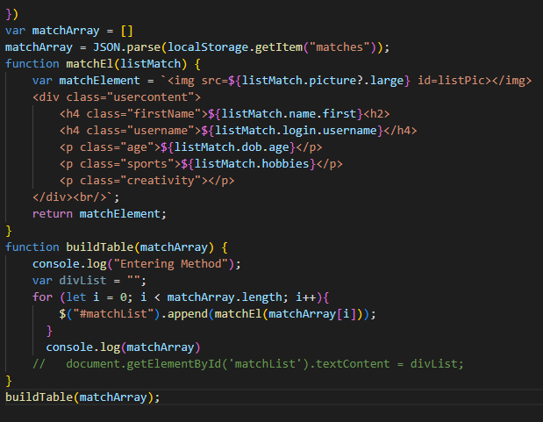
Code Showcase
Maggie
Things I’ve learned:
Over-utilize your in-class project time; it’s hard to make it up on the back end.
Things seem way easier than they look.
Ask for Help!!
Code Here
Blue Ocean: Slide 10

Slide 11
Thank you!! GIVEN a final slide in the presentation WHEN we finish speaking THEN the audience may ask questions.
Blue Ocean: Slide 11

